Slide 1


CLOUD COMPUTING AND CONFENDENTIAL COMPUTING
CSA1003-SOFTWARE ENGINEERING
BY
S.PRATEEKSHA
192572137

Slide 2
Introduction
What is Cloud Computing?
Why organizations use the cloud
Need for security and privacy in cloud environments
Introduction to Confidential Computing
Cloud computing provides computing resources over the Internet.
Resources include:
Servers
Storage
Databases
Networking
Software
Users can access resources without maintaining physical infrastructure.

Slide 3
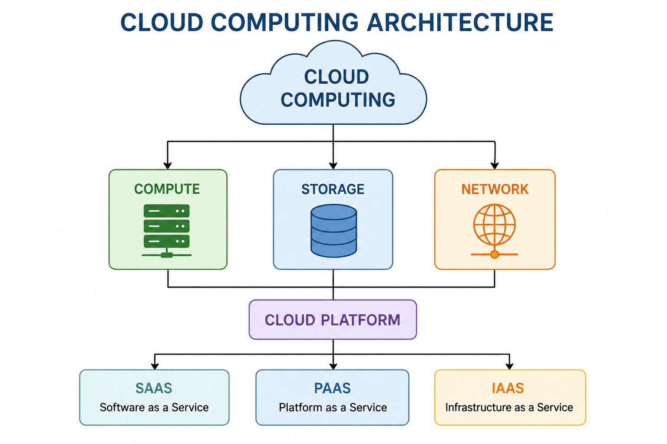
Cloud Computing Architecture

Slide 4
Cloud Service Models
1. IaaS – Infrastructure as a Service
Provides virtual servers, storage, and networking.
Users manage the operating system and applications.
Example: Amazon EC2.
2. PaaS – Platform as a Service
Provides a platform to develop and deploy applications.
Developers do not need to manage the underlying infrastructure.
Example: Google App Engine.
3. SaaS – Software as a Service
Provides ready-to-use software through the Internet.
Users only need to use the application.
Example: Google Drive, Microsoft 365

Slide 5
Cloud Security Challenges
🔐 Data Privacy – Sensitive information must be protected.
🚨 Data Breaches – Unauthorized users may access cloud data.
👤 Unauthorized Access – Weak authentication can expose resources.
🏢 Insider Threats – Authorized users may misuse sensitive data.
🔄 Multi-Tenancy – Multiple customers share the same cloud infrastructure.
🦠 Cyber Attacks – Cloud services can be targeted by various attacks.
🔒 Data Protection – Data needs protection when stored, transmitted, and processsed

Slide 6
Confidential Computing?
Confidential computing is a security technology that protects data while it is being processed by using a protected hardware-based environment called a Trusted Execution Environment (TEE).
Explain the important difference:
Traditional cloud security:
Data protected while stored → Encryption
Data protected while transmitted → Encryption
Data may be exposed while being processed
Confidential computing:
Protects data during processing as well.

Slide 7
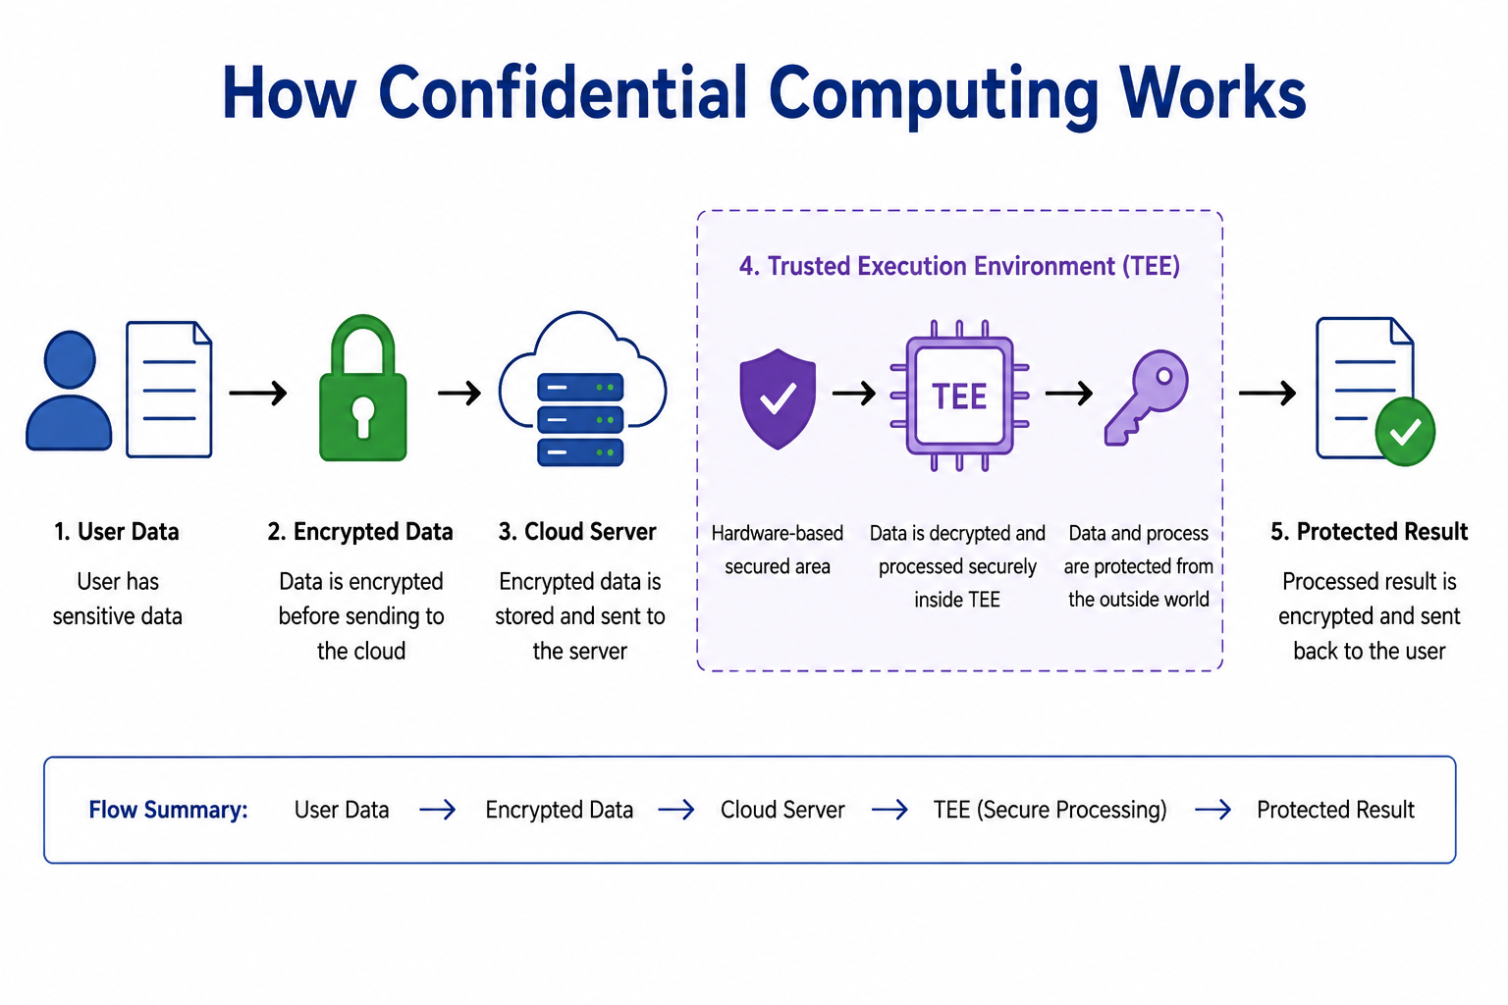
How Confidential Computing Works

Slide 8
Cloud Computing | Confidential Computing
Provides computing resources | Protects data during processing
Focuses on scalability and availability | Focuses strongly on data confidentiality
Uses virtual machines/containers/services | Uses trusted execution environments
Data can be encrypted at rest/in transit | Adds protection while data is in use
Main goal: flexible computing | Main goal: secure computation

Slide 9
Applications
Healthcare data
Banking and financial services
Government systems
AI/ML processing
Collaborative data analysis
Sensitive business information
Multi-party computation environments

Slide 10
Advantages and Limitations
Advantages
Protects sensitive data during processing
Reduces exposure to cloud infrastructure
Helps protect against certain privileged-access threats
Improves privacy
Useful for sensitive workloads
Limitations
Hardware support is required
Additional implementation complexity
Possible performance overhead
Requires proper key and attestation management
Not a replacement for all other security controls

Slide 11
Conclusion
Cloud computing provides scalable and flexible computing resources.
Cloud environments introduce important security and privacy challenges.
Confidential computing protects sensitive information while it is being processed.
Trusted Execution Environments are an important technology behind confidential computing.
Combining cloud computing + encryption + confidential computing can provide stronger protection for sensitive workload

Slide 12
Thank you

